Slide 1
Automatic Speech Recognition (ASR) -
ASR
  incoming acoustic waveform ->sequence of linguistic words
Speech is the most natural means of communication for humans and usually learned to a high degree of proficiency at a very early age.
ASR Applications:
  Natural human-machine communication
  Interactive problem solving
  Telecommunications
    Cost reduction (replace human operators)
    Revenue generation (new services)
  Hands-free operation
  Dictation & automatic transcription
  Aids for handicapped
  Automatic language translation

Slide 2
Speech Recognition
Modal
Generation
Input
Signal
Processing
Pattern
Matching
Output
Feature
Extraction
Training
Testing
Acoustic
Model
Matching
Symbol sequence
Language
Model
Matching
Sentence Hypothesis

Slide 3
The Speech Recognition Problem
If we know the signal patterns that represent every spoken word beforehand, we could try to identify the words whose patterns best match the input
  word patterns are never reproducible exactly
  How do we represent these signal patterns?
  Given this uncertainty, how do we compare the input to known patterns?
Speech recognition is the study of these problems

Slide 4
Why is Speech Recognition Difficult?
Tremendous range of variability in speech, even though the message may be constant:
  Human physiology: squeaky voice vs deep voice
  Speaking style: clear, spontaneous, slurred or sloppy
  Speaking rate: fast or slow speech→Speaking rate can change within a single sentence
  Emotional state: happy, sad, etc.
  Emphasis: stressed speech vs. unstressed speech
  Accents, dialects, foreign words
  Environmental or background noise
  Even the same person never speaks exactly the same way twice
In addition:
  Large vocabulary and infinite language
  Absence of word boundary markers in continuous speech
  Inherent ambiguities: “I scream” or “Ice cream”?

Slide 5
Technological Challenges
Representations of spoken words are inexact
  Even the same person never says a given sentence exactly the same way twice
  No representation can capture the infinite range of variations
  Yet, humans have apparently no difficulty
    They adapt to new situations effortlessly
  The problem is understanding and representing what is invariant
Pattern matching is necessarily inexact
  Given the above, there will always be mismatches in pattern matching, and hence misrecognitions
    Even humans are not perfect!
  Finding optimal pattern matching algorithms, and hence minimizing misrecognitions, is another challenge

Slide 6
Technological Challenges (contd.)
As target vocabulary size increases, complexity increases
  Computational resource requirements increase
    Memory size to store patterns
    Computational cost of matching
  Most important, the degree of confusability between words increases
    More and more words begin sounding alike
    Requires finer and finer models (patterns)
    Further aggravates the computational cost problem

Slide 7
Speech recognition techniques
Template based approach
Acoustic phonetic or knowledge based approach
Statistical approach
Learning based approach
Artificial Intelligence (AI) approach
Manner Based Lexically Driven approach

Slide 8
Frequency Domain Parameters
Filter Bank Analysis
Short-term spectral analysis
CC
Formant Parameters
MFCC, Delta MFCC, Delta-Delta MFCC
Time Domain Parameters
LPC
Shape Parameters

Slide 9
Time-Frequency Parameters
Perceptual Linear Prediction (PLP):
Combines the LPC and filter-bank approaches by fitting an all-pole model to the set of energies produced by a perceptually motivated filter bank and then computing the cepstrum from the model parameters.

Slide 10
Pattern Recognition
What is Pattern Recognition?
  “The assignment of a physical object or event to one of several pre-specified categories” -- Duda & Hart
A pattern is an object, process or event that can be given a name.
A pattern class (or category) is a set of patterns sharing common attributes and usually originating from the same source.
During recognition (or classification) given objects are assigned to prescribed classes.
A classifier is a machine which performs classification
Approaches:
  Statistical PR: based on underlying statistical model of patterns and pattern classes.
  Structural (or syntactic) PR: pattern classes represented by means of formal structures as grammars, automata, strings, etc.

Slide 11
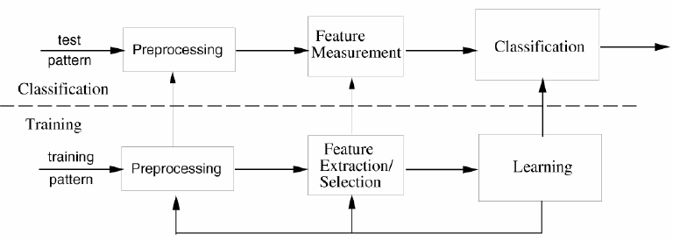
Pattern Recognition

Slide 12
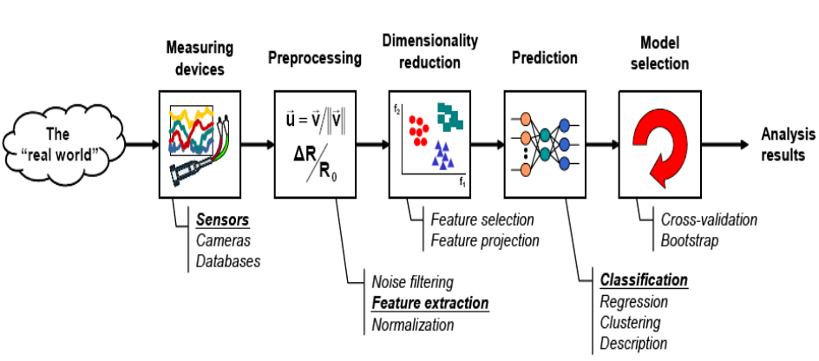
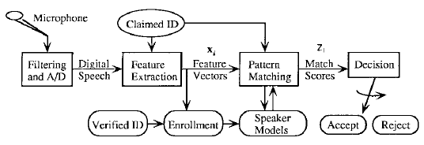
Components of PR System
A basic pattern classification system contains
  Data Acquisition
  Feature Extraction mechanism (manual or automated)
  Pattern Matching
  Making an Accept/Reject Decision (Classification algorithm)
  A set of examples (training set) already classified or described
    Speaker Reference Models

Slide 13
Speech recognition techniques
Template based approach
Acoustic phonetic or knowledge based approach
Statistics based approach
Learning based approach
Artificial Intelligence (AI) approach
Manner Based Lexically Driven approach

Slide 14
ASR: Pattern Matching Methods
Vector Quantization (VQ)
  Code book Models are used
  A VQ codebook is designed by standard clustering procedures for each enrolled speaker using his training data, usually based upon reading a specific text.
  The pattern match score is the distance between an input vector and the minimum distance code word in the VQ codebook C
Dynamic Time Warping (DTW)
  Template Models are used
  A text-dependent template model is a sequence of templates (X1 ..XN) that must be matched to an input sequence (Y1 ..YM).
Hidden Markov Models (HMM)
  Statistical Models are used
  Using a stochastic model, the pattern-matching problem can be formulated as measuring the likelihood of an observation (a feature vector of a collection of vectors from the unknown speaker) given the speaker model

Slide 15
PR System: Features and Patterns
Feature
  Feature is any distinctive aspect, quality or characteristic
    Features may be symbolic (i.e., color) or numeric (i.e., height)
  Definitions
    The combination of d features is represented as a d-dimensional column vector called a feature vector
    The d-dimensional space defined by the feature vector is called the feature space
    Objects are represented as points in feature space. This representation is called a scatter plot
Pattern
  Pattern is a composite of traits or features characteristic of an individual
  In classification tasks, a pattern is a pair of variables {x,ω} where
    x is a collection of observations or features (feature vector)
    ω is the concept behind the observation (label)

Slide 16
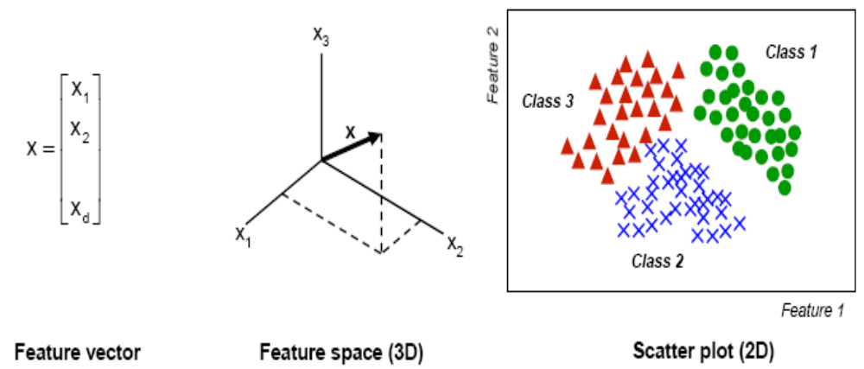
PR System: Features and Patterns

Slide 17
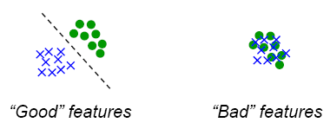
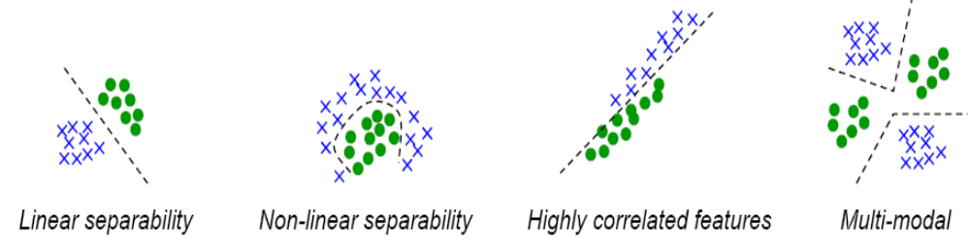
PR System: Features and Patterns
What makes a “good” feature vector?
  The quality of a feature vector is related to its ability to discriminate examples from different classes
    Examples from the same class should have similar feature values
    Examples from different classes have different feature values
More feature properties

Slide 18



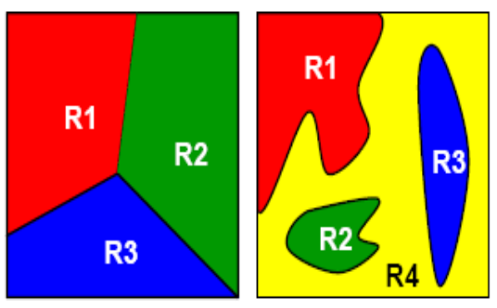



PR System: Classifiers
The task of a classifier is to partition feature space into class-labeled decision regions
  Borders between decision regions are called decision boundaries
  The classification of feature vector x consists of determining which decision region it belongs to, and assign x to this class
A classifier can be represented as a set of discriminant functions
  The classifier assigns a feature vector x to class ωt if fi(x)>fj(x); j‡ i
Feature vector
Class identifier
Discriminant function

Slide 19
Vector Quantization
Create a training set of feature vectors
Cluster them into a small number of classes
Represent each class by a discrete symbol
We’ll define a
  Codebook, which lists for each symbol
  A prototype vector, or codeword
If we had 256 classes (‘8-bit VQ’),
  A codebook with 256 prototype vectors
  Given an incoming feature vector, we compare it to each of the 256 prototype vectors
  We pick whichever one is closest (by some ‘distance metric’)
  And replace the input vector by the index of this prototype vector

Slide 20
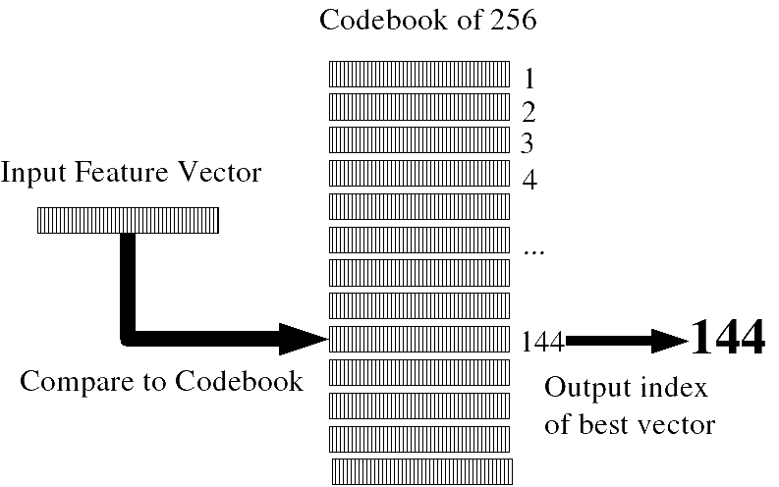
VQ

Slide 21
VQ requirements
A distance metric or distortion metric
  Specifies how similar two vectors are
  Used:
    to build clusters
    To find prototype vector for cluster
    And to compare incoming vector to prototypes
A clustering algorithm
  K-means, etc.

Slide 22
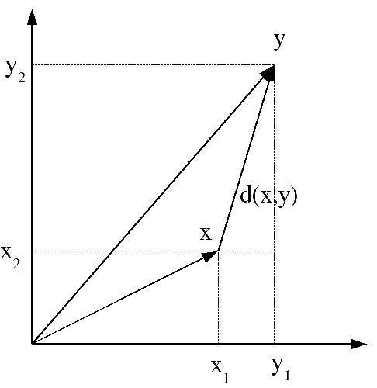
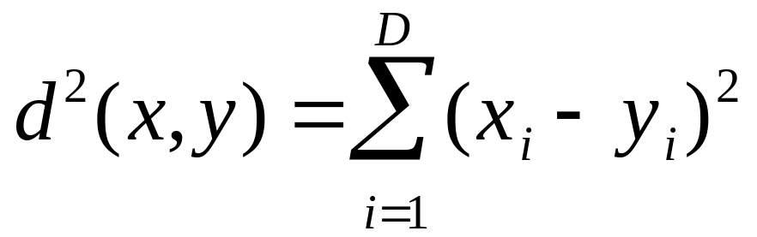
Distance metrics
Simplest:
  (square of) Euclidean distance
  Also called ‘sum-squared error’

Slide 23
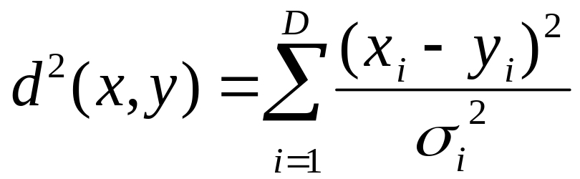
Distance metrics
More sophisticated:
  (square of) Mahalanobis distance
  Assume that each dimension of feature vector has variance σ²
  Equation above assumes diagonal covariance matrix

Slide 24
Training a VQ system (generating codebook): K-means clustering
1. Initialization
choose M vectors from L training vectors (typically M=2^{B})
as initial code words… random or max. distance.
2. Search:
for each training vector, find the closest code word,
assign this training vector to that cell
3. Centroid Update:
for each cell, compute centroid of that cell. The
new code word is the centroid.
4. Repeat (2)-(3) until average distance falls below threshold (or no change)
Slide from John-Paul Hosum, OHSU/OGI

Slide 25






Dynamic Time Warping (DTW)
Goal: Given two utterances, find “best” alignment between pairs of frames from each utterance.
(A)
(B)
The path through this matrix shows the best pairing of frames from utterance A with
utterance B:
This path can be considered
the best “warping” between
A and B.
time (frame) of (B)
time (frame) of (A)

Slide 26
Dynamic Time Warping (DTW)
Dynamic Time Warping
  Requires measure of “distance” between 2 frames of speech,
  one frame from utterance A and one from utterance B.
  Requires heuristics about allowable transitions from one frame in A to another frame in A (and likewise for B).
  Uses inductive algorithm to find best warping.
  Can get total “distortion score” for best warped path.
Distance:
  Measure of dissimilarity of two frames of speech
Heuristics:
  Constrain begin and end times to be (1,1) and (T,T)
  Allow only monotonically increasing time
  Don’t allow too many frames to be skipped
  Can express in terms of “paths” with “slope weights”

Slide 27
Dynamic Time Warping (DTW)
Does not require that both patterns have the same length
We may refer to one speech pattern as the “input” and the other speech pattern as the “template”, and compare input with template.
For speech, we divide speech signal into equally-spaced frames (e.g. 10 msec) and compute one set of features per frame. The local distance measure is the distance between features at a pair of frames (one from A, one from B).
Local distance between frames called d. Global distortion from beginning of utterance until current pair of frames called D.
DTW can also be applied to related speech problems, such as matching up two similar sequences of phonemes.

Slide 28
Template Matching: DTW
Clearly, it is necessary to dynamically adjust the durations of various segments within the input and template speech
  How to optimally (and automatically!) align the template to the input speech to obtain the best possible match?
  Brute force? Try all possible segmentations and alignments?
    Computationally far too expensive!
    Besides, precise segment boundaries may not even be known
An efficient algorithm for finding an optimal alignment exists:
  Dynamic Time Warping or DTW
DTW in speech recognition is essentially based on dynamic programming (DP)
  DP is a well known optimization algorithm in Operations Research

Slide 29
Induction (Dynamic Programming)
To find value X at step t in a process (X(t)), where X(t) can be computed from X(t-1):
  Compute X(1)
  For m = 2 to t:
    Use value from previous iteration (X(m-1)) to determine X(m)
  X(t) is last result from Step (2).
For speech, X(t) will be the “best” value at time t, either in terms of “least distortion” or “highest probability”.
By showing that the best value at time t depends only on the previous values at time t-1, the best value for an entire utterance (the end of the signal, time T) can be computed.

Slide 30
Induction (Dynamic Programming)
“Greedy Algorithm”:
  Make a locally-optimum choice going forward at each step, hoping (but not guaranteeing) that the globally-optimum will be found at the last step.
Travelling Salesman Problem:
  Given a number of cities, what is the shortest route that visits each city exactly once and then returns to the starting city?
Vancouver
21
Gresham
26
Hillsboro
35
146
183
167
Bend
53
55
58
132
Salem

Slide 31
DP: String Matching Example
First, consider a similar problem, but visually easier to grasp: Aligning two text strings to find how similar they are
  E.g. spelling errors detected by google:
    Type query string “RaviShanker” into google
    Google responds: Did you mean “RaviShankar”?
    How does it know this?
“RaviShankar” is its template (among many others), and “RaviShanker” is the input
  By measuring the dissimilarity between the two, it could guess that perhaps the template was the intended input

Slide 32
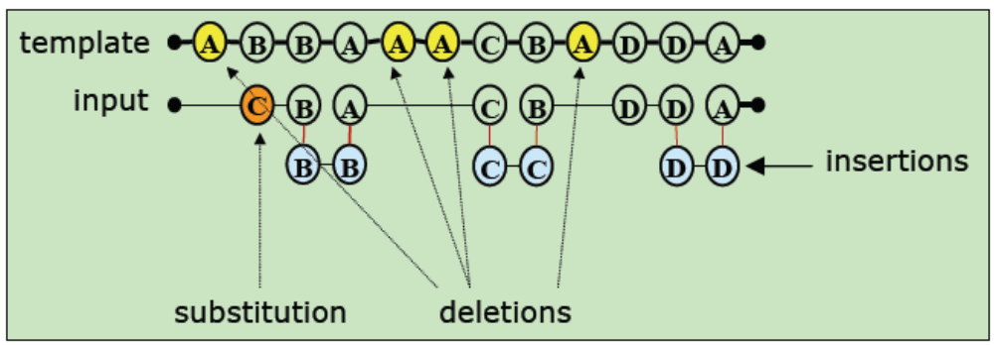
String Matching Example
The example contained just a substitution error (e for a)
In general, there can be three types of string errors:
  Substitution: a template letter has been changed in the input
  Insertion: a spurious letter is introduced in the input
  Deletion: a template letter is missing from the input
Hypothetical example:
  Template : ABBAAACBADDA
  Input : CBBBACCCBDDDDA

Slide 33
String Matching Problem
Given two arbitrary strings, find the minimum edit distance between the two:
  Edit distance = the minimum number of editing operations needed to convert one into the other
  Editing operations: substitutions, insertions, deletions
  Often, the distance is also called cost
This minimum distance is a measure of the dissimilarity between the two strings
  Also called the Levenshtein distance

Slide 34
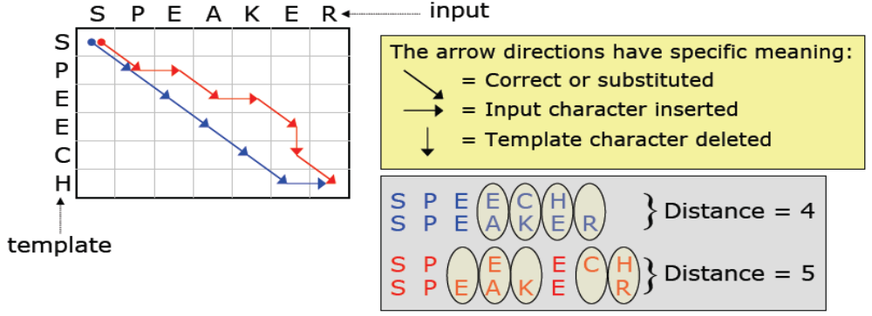
String Edit Distance Computation
Measuring edit distance is best visualized as a 2-D diagram of the template being aligned or warped to best match the input
  Two possible alignments of template to input are shown, in blue and red
Wanted: MINIMUM edit distance: i.e. inherent dissimilarity
  Over all possible paths from corner to corner

Slide 35
Minimum String Edit Distance
This is an example of a search problem, since we need to search among all possible paths for the best one
First possibility: Brute force search
  Exhaustive search through all possible paths from top-left to bottom-right, and choose path with minimum cost
  But, computationally intractable; exponentially many paths!
A path is a connected sequence made up of the three types of arrows: diagonal, vertical and horizontal steps
Solution: Dynamic Programming (DP)
  Find optimal (minimum cost) path by utilizing (re-using) optimal sub-paths
  Crucial to virtually all major speech recognition systems

Slide 36
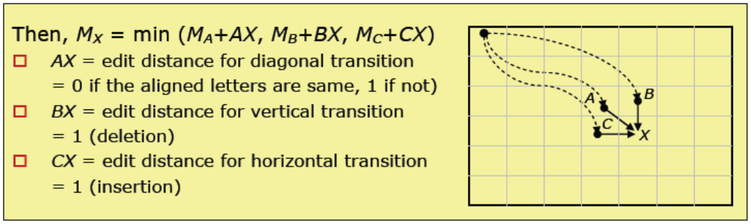
Minimum String Edit Distance: DP
Central idea: formulate optimal path to any intermediate point X in the matrix in terms of optimal paths of all its immediate predecessors
  Let M_{X}= Min. path cost from origin to any pt. X in matrix
  Say, A, B and C are all of X’s predecessors
  Assume M_{A}, M_{B} and M_{C} are known (shown by dotted lines)
Hence, start from the origin, and compute min. path cost for every matrix entry, proceeding from top-left to bottom right corner
  Min. edit distance between the two strings = value at bottom right corner

Slide 37
Minimum String Edit Distance: DP
Although the matrix entries can be filled in any order (for any entry, we only need to ensure that all its predecessors are evaluated), it helps to proceed methodically, once column (i.e. one input character) at a time:
  Consider each input character, one at a time
  Fill out min. edit distance for that entire column before moving on to next input character
  Forces us to examine every unit of input (in this case, every character) one at a time
    Allows each input character to be processed as it becomes available

Slide 38
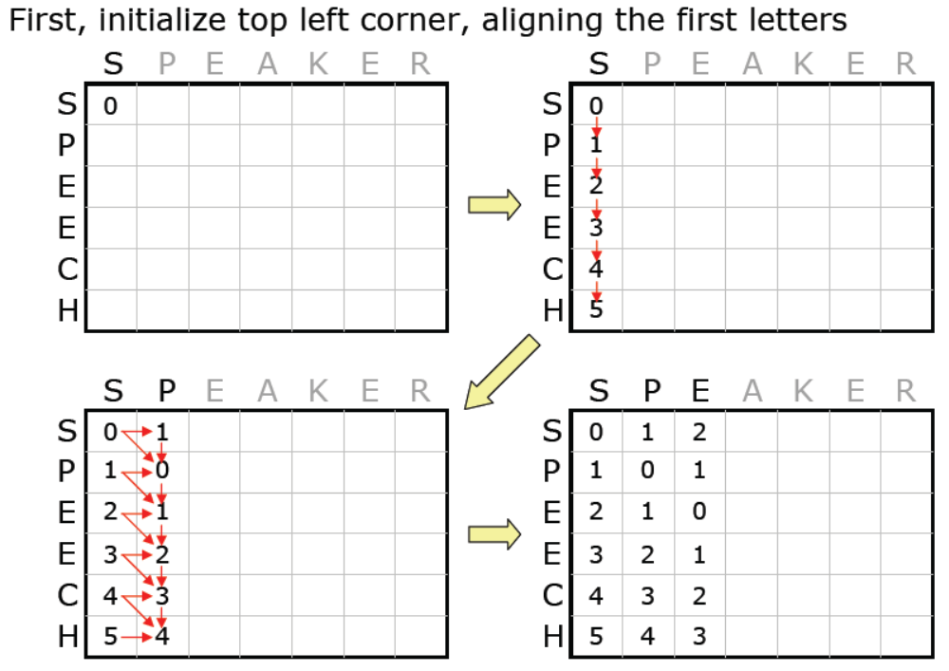
DP Example

Slide 39
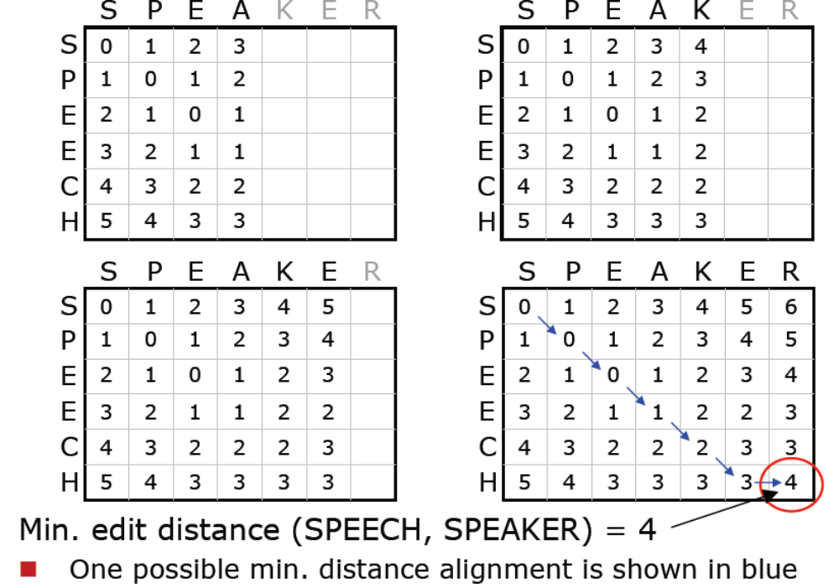
DP Example

Slide 40
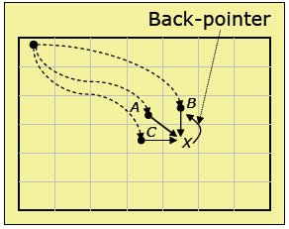
DP: Finding the Best Alignment
The algorithm so far only finds the cost, not the alignment itself
How do we find the actual path that minimizes edit distance?
  There may be multiple such paths, any one path will suffice
To determine the alignment, we modify the algorithm as follows
Whenever a cell X is filled in, we maintain a back-pointer from X to its predecessor cell that led to the best score for X
  Recall M_{X}= min (M_{A}+AX, M_{B}+BX, M_{C}+CX)
  So, if M_{B}+BX happens to be the minimum we create a back-pointer X->B
  If there are ties, break them arbitrarily
Thus, every cell has a single back-pointer
At the end, we trace back from the final cell to the origin, using the back-pointers, to obtain the best alignment

Slide 41
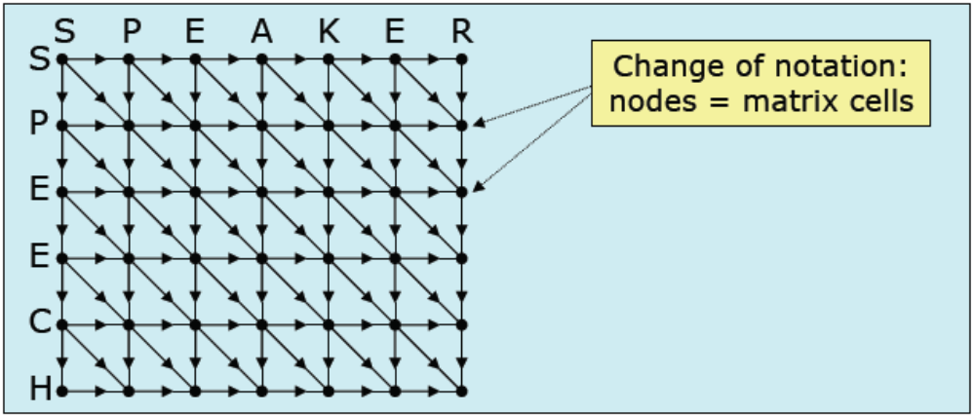
Finding the Best Alignment: DP Trellis
The 2-D matrix, with all possible transitions filled in, is called the search trellis
DP does not require that transitions be limited to the three types used in the example
The primary requirement is that the optimal path be computable recursively, based on a node’s predecessors optimal sub-paths

Slide 42
Search Trellis
The search trellis is arguably one of the most crucial concepts in modern day decoders!
Just about any decoding problem is usually cast in terms of such a trellis
It is then a matter of searching through the trellis for the best path
The DP algorithm, at every node (cells of the DP matrix), maintains a path cost for the best path from the origin to that node
  In string matching, this cost is the substring minimum edit distance
  Path costs are computed by accumulating local node and edge costs (allowed transitions) according to the recursive formulation already seen (minimizing cost)
One may also use a similarity measure, instead of dissimilarity
  In this case DP algorithm should try to maximize the total path score

Slide 43
Applications of DP string matching
How might google recognize “RaviShanker” as a mistyped version of “RaviShankar”?
One hypothetical heuristic:
  Google maintains a list of highly popular query strings
    These are the templates; “RaviShankar” is one of them
When a user types in a query, the string-matched to every template, using DP
If a template matches exactly, there is no spelling error
If a single template has one overall error (edit distance = 1), google can ask Did you mean “…”
Otherwise, do nothing
  Either multiple templates have edit distance = 1, or
  Minimum edit distance > 1
Here, we see the implicit introduction of a confidence measure
  A decision based on the value of the min. edit distance

Slide 44
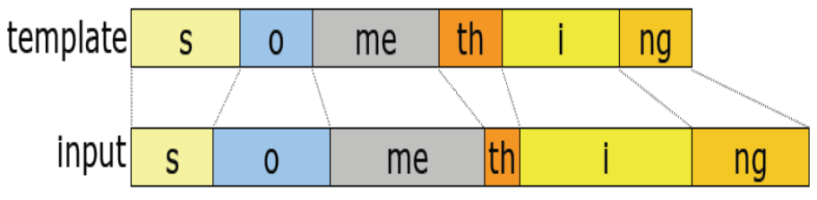
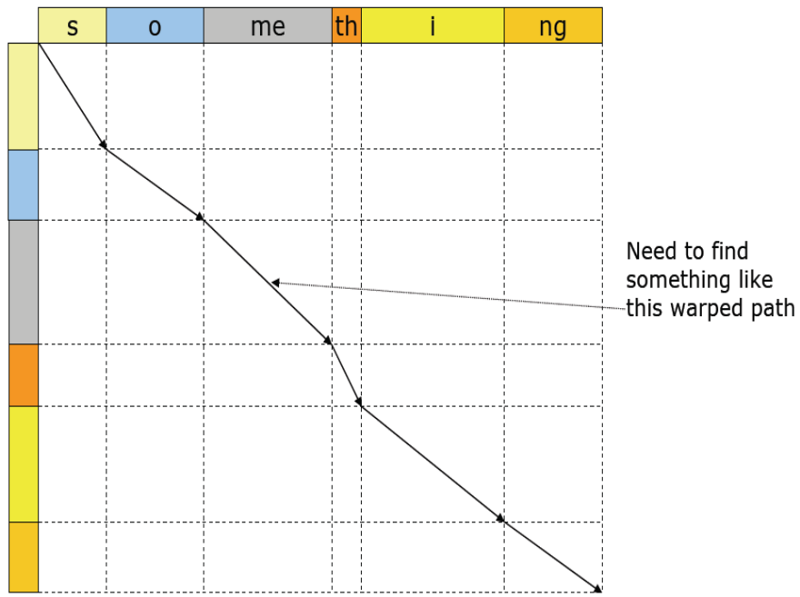
DTW: DP for Template Matching
Template matching for speech: dynamic time warping
  Inputs and templates are sequences of feature vectors instead of letters
Intuitive understanding of why DP-like algorithm might work to find a best alignment of a template to the input:
  We need to search for a path that finds the shown alignment:

Slide 45
DTW: Adapting Concepts from DP
Some concepts from string matching need to be adapted to this problem
  What are the allowed set of transitions in the search trellis?
  What are the edge and local node costs?
Once these questions are answered, we can apply essentially the same DP algorithm to find a minimum cost match (path) through the search trellis

Slide 46
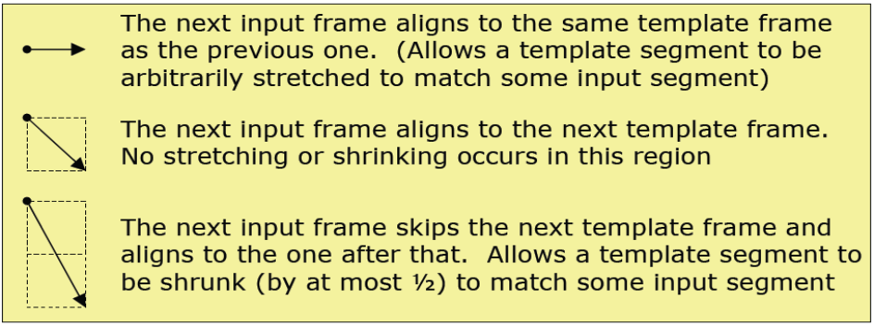
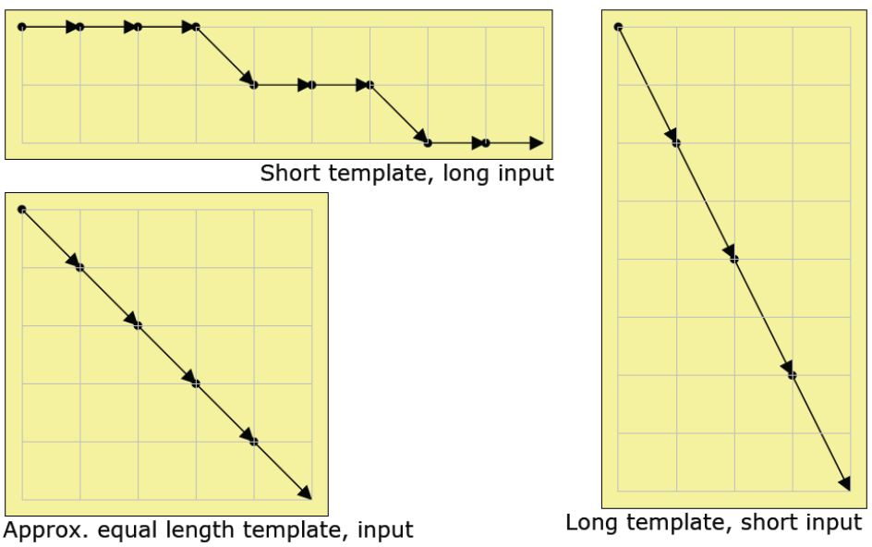
DTW: Determining Transitions
The main modes of distortion are stretching and shrinking of speech segments, owing to different speaking rates
  Of course, we do not know a priori what the distortion looks like
Also, since speech signals are continuous valued instead of discrete, there is really no notion of insertion
  Every input frame must be matched to some template frame
For meaningful comparison of two different path costs, their lengths must be kept the same
  So, every input frame is to be aligned to a template frame exactly once
Typical transitions used in DTW for speech:

Slide 47
DTW: Local Edge and Node Costs
Typically, there are no edge costs; any edge can be taken with no cost
Local node costs measure the dissimilarity or distance between the respective input and template frames
Since the frame content is a multi-dimensional feature-vector, what dissimilarity measure can we use?
A simple measure is Euclidean distance; i.e. geometrically how far one point is from the other in the multi-dimensional vector space
  For two vectors X = (x1, x2, x3…xN), and Y = (y1, y2, y3…yN), the Euclidean distance between them is:
    √Σ(xi-yi), i= 1 .. N
  Thus, if X and Y are the same point, the Euclidean distance = 0
  The farther apart X and Y are, the greater the distance
Other distance measure could also be used:
  Manhattan metric or the L1 norm: Σ|Ai–Bi|
  Weighted Minkowski norms: (Σwi|Ai–Bi|^n)^1/n

Slide 48
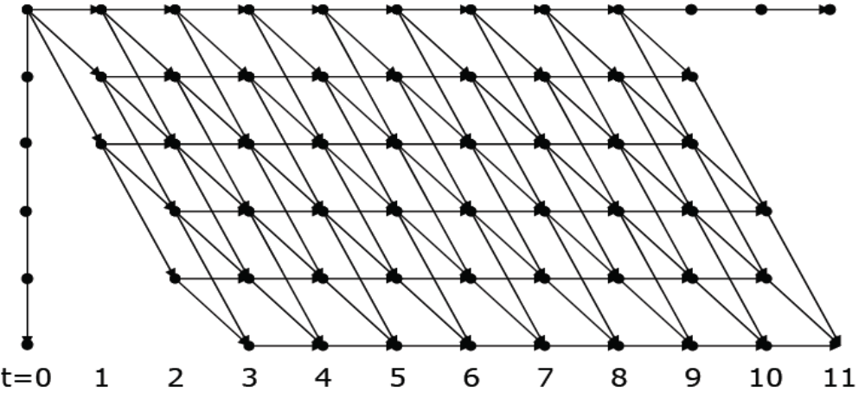
DTW: Algorithm
The transition structure and local edge and node costs are now defined
The search trellis can be realized and the DP algorithm applied to search for the minimum cost path, as before
  Example trellis using the transition types shown earlier:

Slide 49
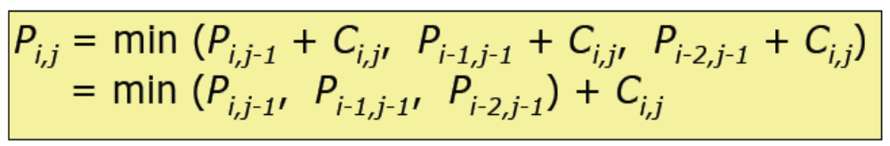
DTW: Algorithm
Let Pi,j= the best path cost from origin to node [i,j] (i.e., where i-th template frame aligns with j-th input frame)
Let Ci,j= the local node cost of aligning template frame i to input frame j (Euclidean distance between the two vectors)
Then, by the DP formulation:

Slide 50
IWR using DTW
We now have a method for measuring the best match of a template to the input speech
How can we apply this to perform isolated word recognition?
  For each word in the vocabulary, pre-record a spoken example (its template)
  For a given input utterance, measure its minimum distance to each template using DTW
  Choose the template that delivers the smallest distance
As easy as that!
  Could implement this on a cell phone for dialing
Is there an efficient way to do this?

Slide 51
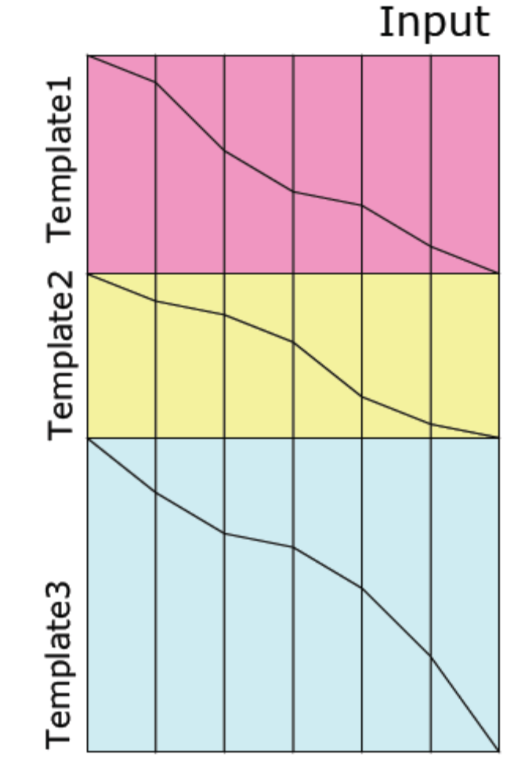
Time Synchronous Search
Since input frames are processed sequentially, the input speech can be matched to all templates simultaneously
The figure shows three such matches going on in parallel
Essentially, every template match is started simultaneously and stepped through the input in lock-step fashion
  Hence the term time synchronous
Advantages
  No need to store the entire input for matching with successive templates
  Matching can proceed as the input comes in
  Enables pruning for computational efficiency
  Other advantages in continuous speech recognition

Slide 52
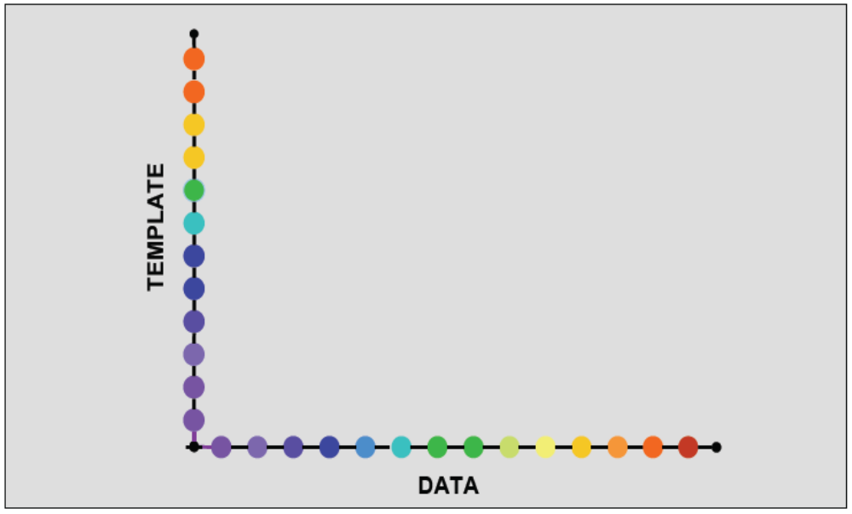
DTW using Single Template: Limitations
As noted in the previous topic, a single template cannot capture all the variations in speech
One alternative already suggested: use multiple templates for each word, and match the input against each one

Slide 53
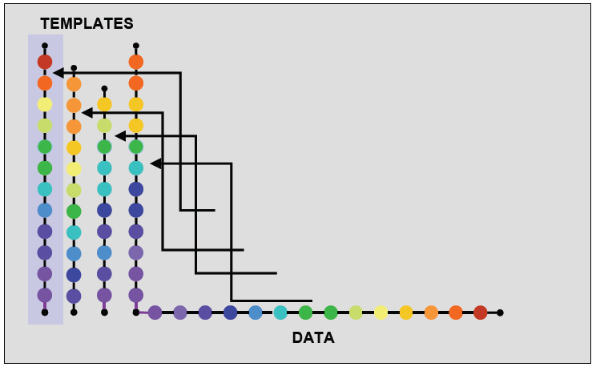
DTW with Multiple Templates
Each template warps differently to best match the input; the best matching template is selected

Slide 54
Problem with Multiple Templates
Finding the best match requires the evaluation of many more templates (depending on the number)
  This can be computationally expensive
    Important for handheld devices, even for small-vocabulary applications
    Think of battery life!
  Need a method for reducing multiple templates into a single one
Even multiple templates do not cover the space of possible variations
  Need mechanism of generalizing from the templates to include data not seen before
We can achieve both objectives by averaging all the templates for a given word

Slide 55
Template Averaging
How can we average the templates when they’re of different lengths?
  Somehow need to normalize them to each other
Solution: Apply DTW
  Pick one template as a “master”
  Align all other templates to it
    Note: This requires not just finding the best cost, but the actual alignment between the template and input frame sequences, using the back-pointers described earlier
  Use the alignments so generated to compute their average
Note: Choosing a different master template will lead to a different average template
  Which template to choose as the master?
    No definitive answer exists
    Only trial and error solutions exist

Slide 56
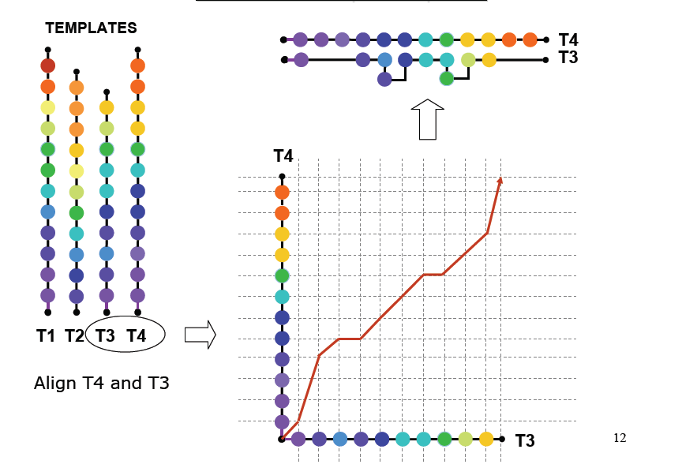
DTW with Multiple Templates

Slide 57
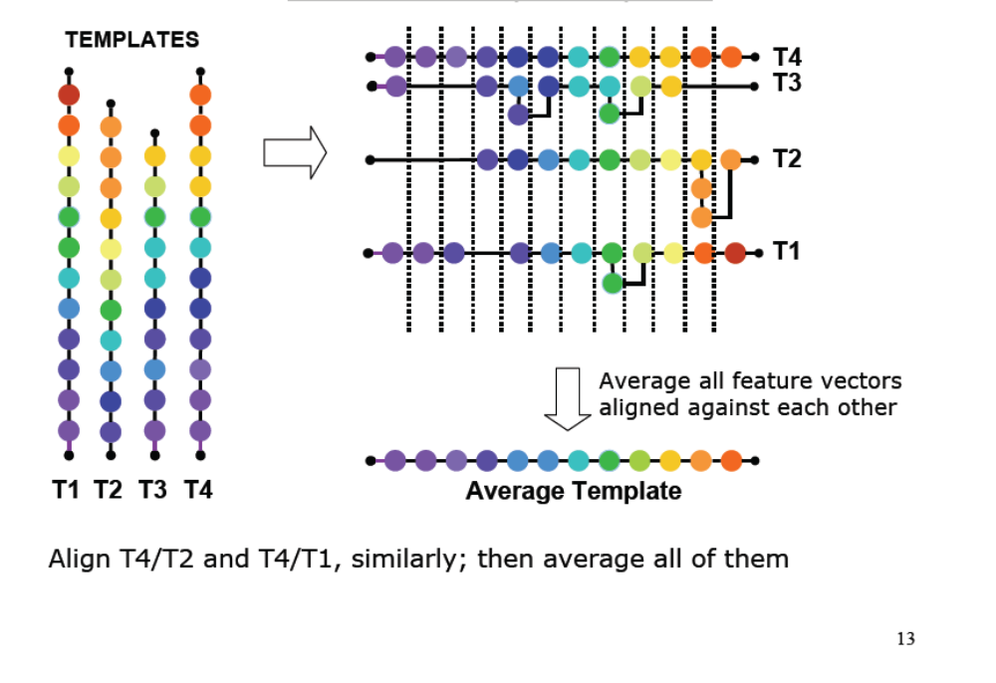
DTW with Multiple Templates

Slide 58
Benefits of Template Averaging
Obviously, we have eliminated the computational cost of having multiple templates for each word
Using the averages of the aligned feature vectors generalizes from the samples
  The average is representative of the templates, and more generally, assumed to be representative of future utterances of the word
The more the number of templates, the better the generalization

Slide 59
Template Size Reduction
Can we do better? Consider the template for “something”:
Here, the template has been manually segmented into 6 segments, where each segment is a single phoneme
Hence, the frames of speech that make up any single segment ought to be fairly alike
If so, why not replace each segment by a single representative feature vector?
  How? Again by averaging the frames within the segment
This gives a reduction in the template size (memory size)

Slide 60
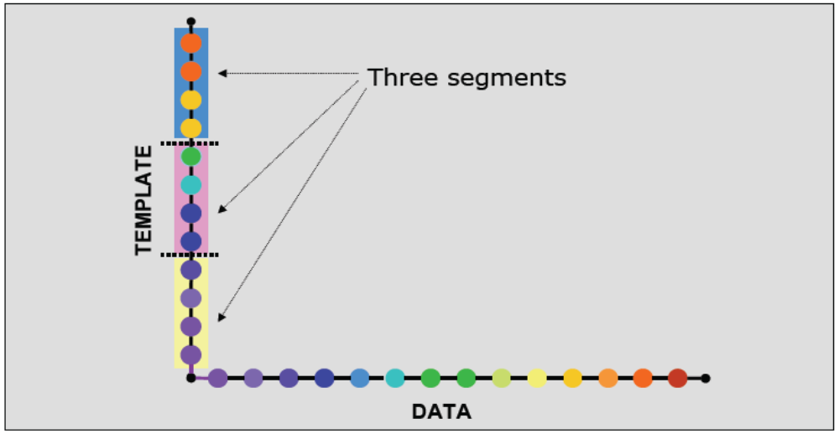
Single Template with Three Segments
The feature vectors within each segment are assumed to be similar to each other.

Slide 61
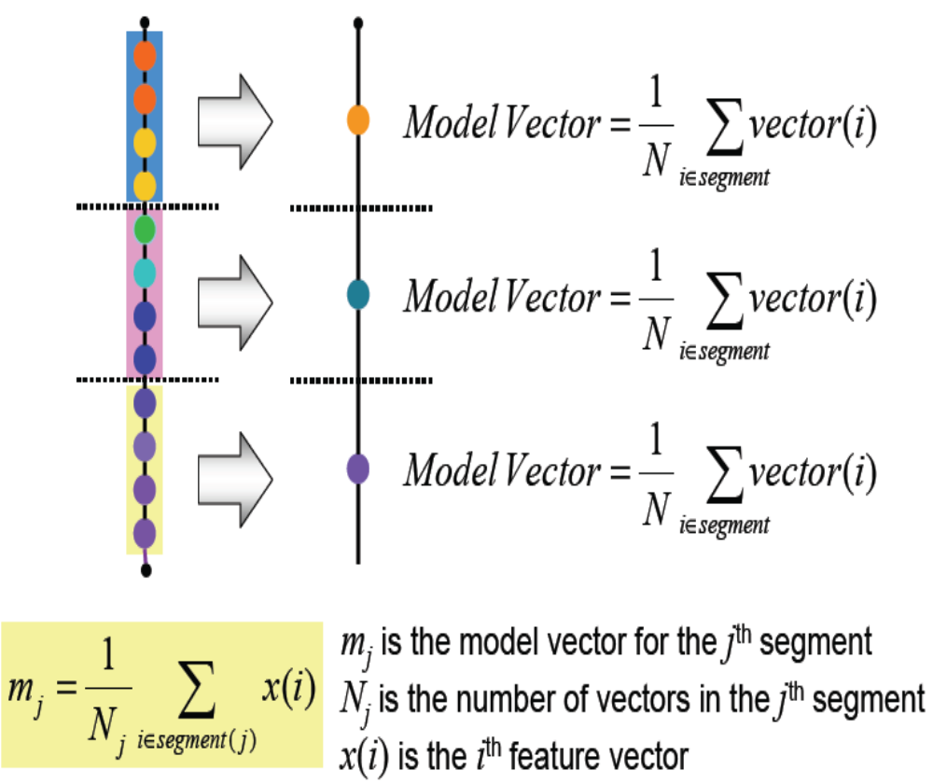
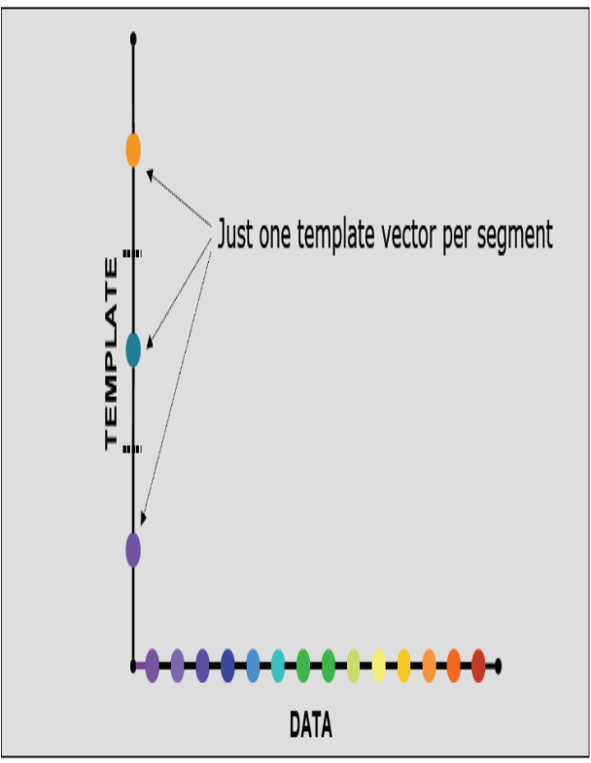
Averaging Each Template Segment

Slide 62
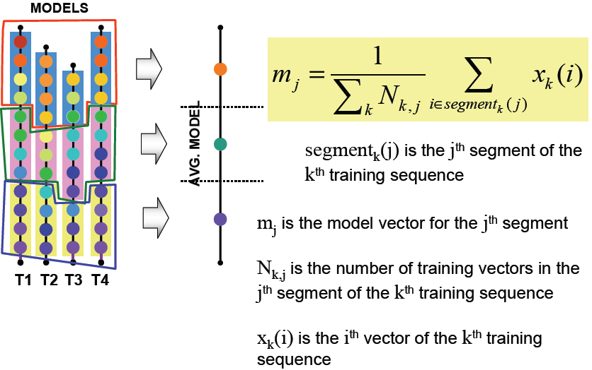
DTW with Multiple Models
Segment all templates
Average each region into a single point

Slide 63
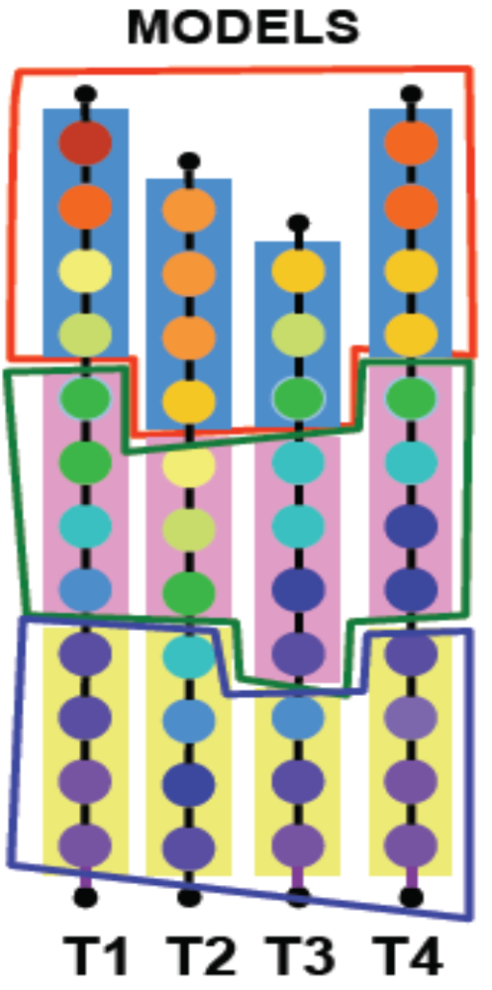
DTW with Multiple Models
The inherent variation between vectors is different for the different segments
  E.g. the variation in the colors of the beads in the top segment is greater than that in the bottom segment
Ideally we should account for the differences in variation in the segments
  E.g. a vector in a test sequence may actually be more matched to the central segment, which permits greater variation, although it is closer, in a Euclidean sense, to the mean of the lower segment, which permits lesser variation

Slide 64
Segmental K-means
Simple uniform segmentation of training instances is not the most effective method of grouping vectors in the training sequences
A better segmentation strategy is to segment the training sequences such that the vectors within any segment are most alike
  The total distance of vectors within each segment from the model vector for that segment is minimum
  For a global optimum, the total distance of all vectors from the model for their respective segments must be minimum
This segmentation must be estimated
The segmental K-means procedure is an iterative procedure to estimate the optimal segmentation

Slide 65
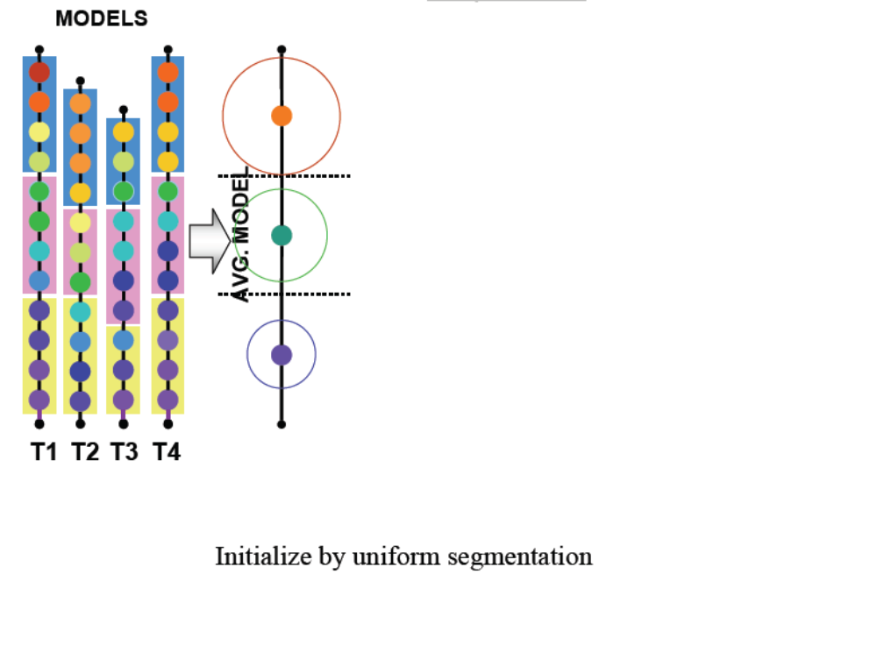
Training with Multiple Vector Sequences

Slide 66
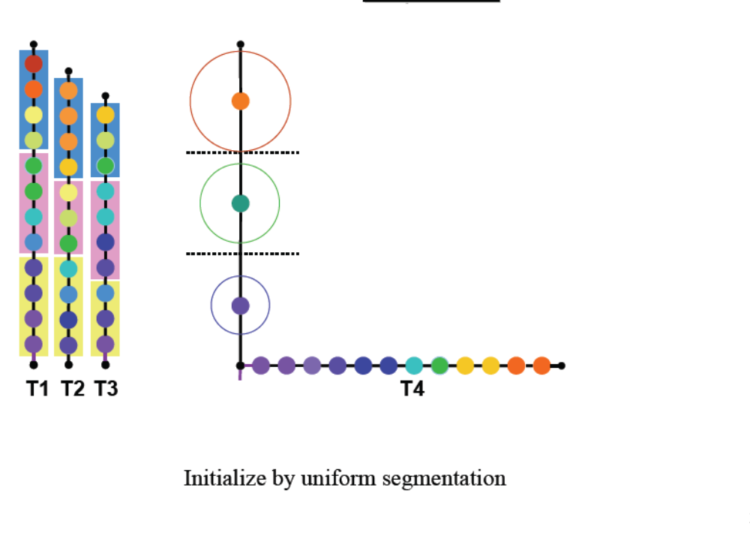
Training with Multiple Vector Sequences

Slide 67
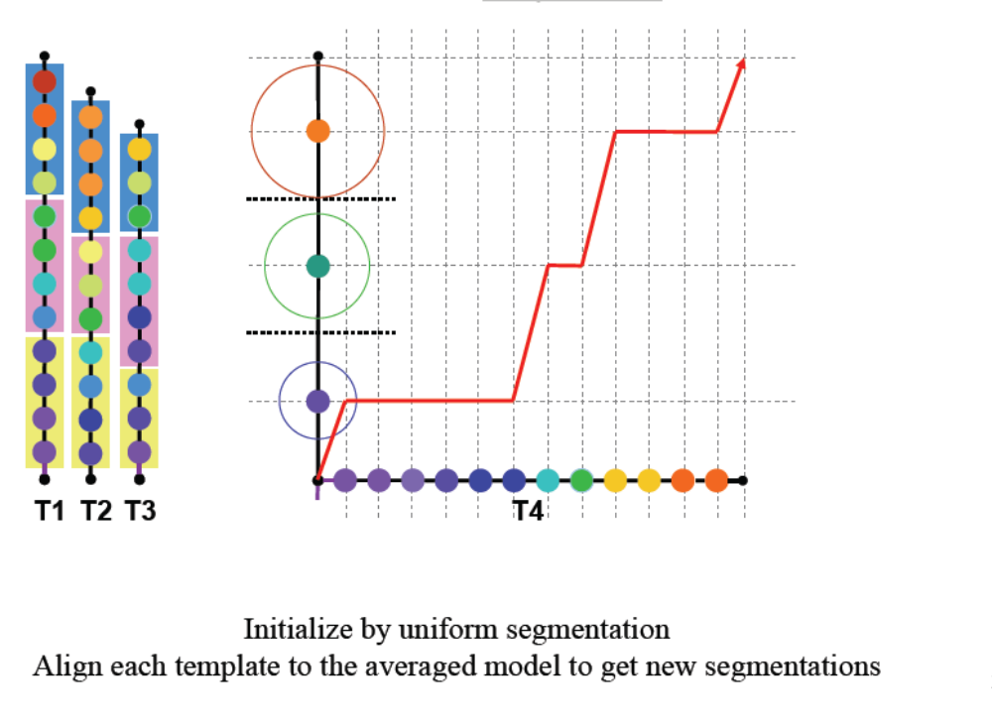
Training with Multiple Vector Sequences

Slide 68
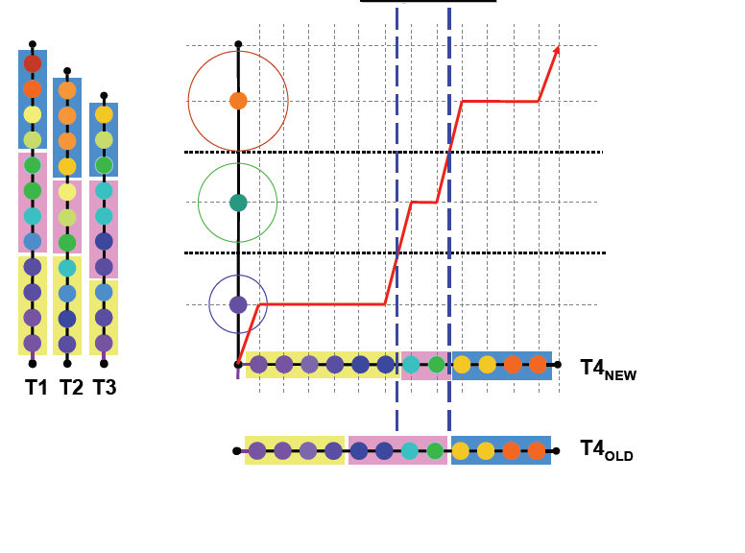
Training with Multiple Vector Sequences

Slide 69
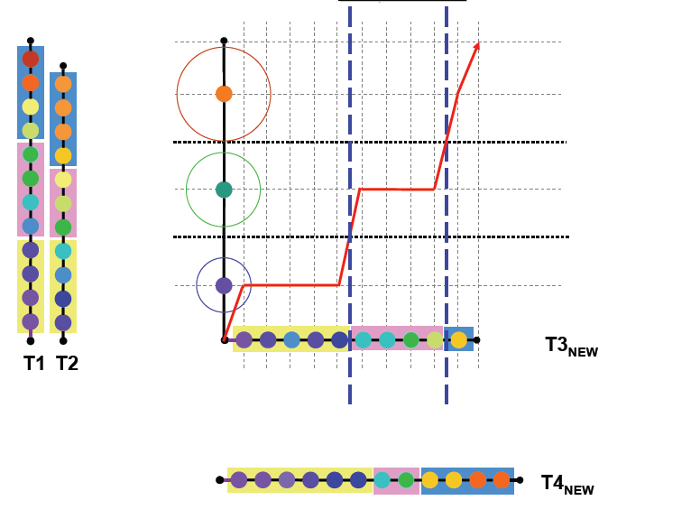
Training with Multiple Vector Sequences

Slide 70
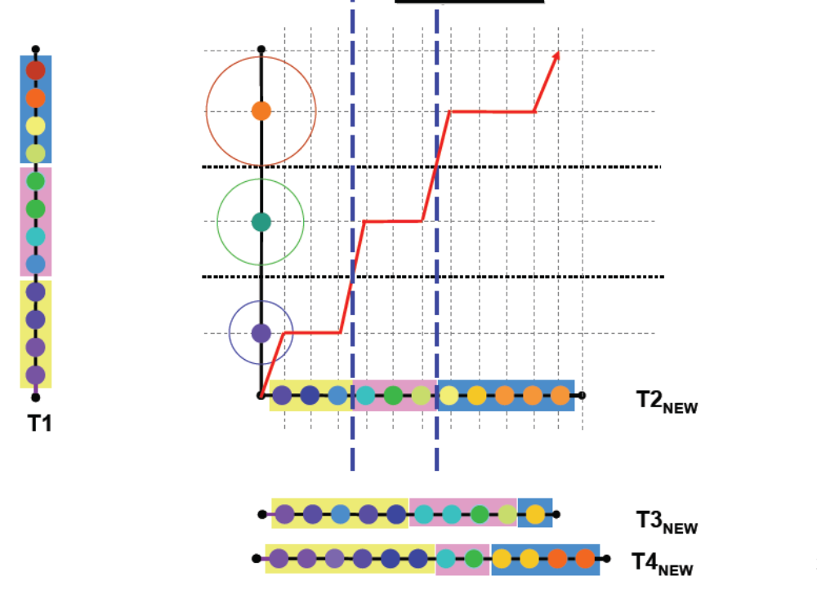
Training with Multiple Vector Sequences

Slide 71
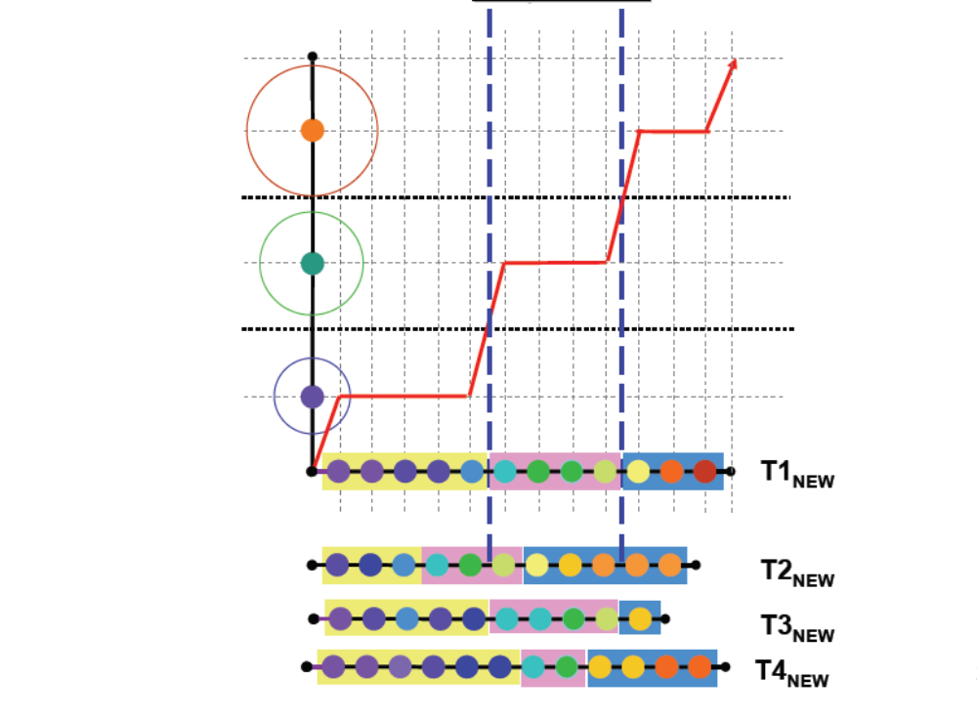
Training with Multiple Vector Sequences

Slide 72
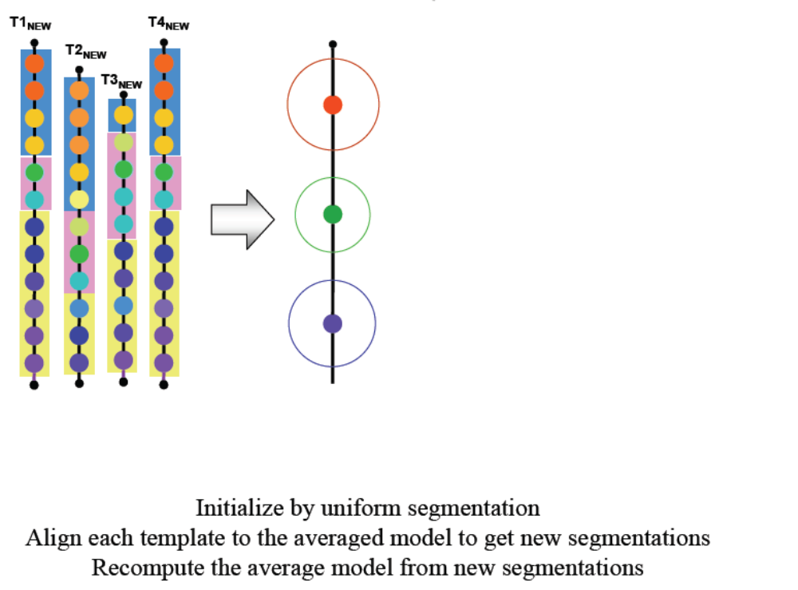
Training with Multiple Vector Sequences

Slide 73
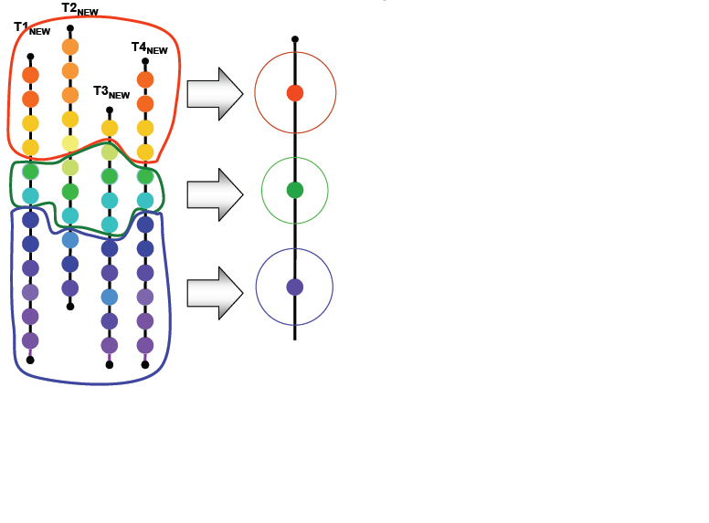
Training with Multiple Vector Sequences

Slide 74
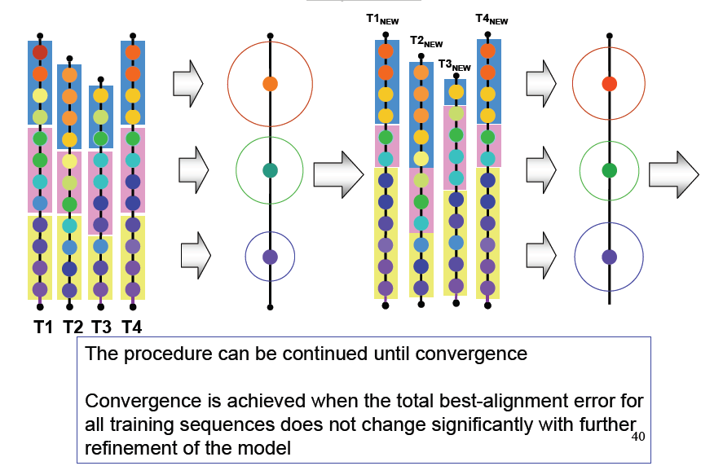
Training with Multiple Vector Sequences

Slide 75
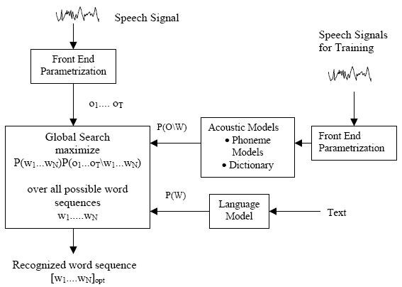
STATISTICAL ASR ARCHITECTURE

Slide 76
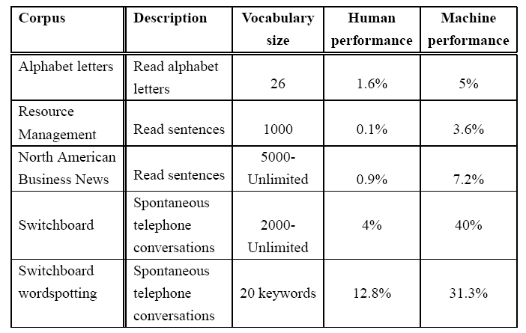
ASR: Machine vs. Human Performance
Word-error rate: Matched Condition

Slide 77
Lexically Driven Manner Based Speech Recognition Model
Input Speech
Word Boundary
Detection
Hierarchy-1
Manner-Based Labeling
Pseudo-Word
Formation
Lexical
Expert System
Acoustic Phonetics
Classifier
Recognized Word
Hierarchy-2

Slide 78
Limitation of Current ASR using stochastical Hidden Markov Models (HMMs)
Current automatic speech recognition systems (ASRs) have pushed the possibilities of stochastical Hidden Markov Models (HMMs) to their limits but have not reached the performance of human listeners.
HMMs need inconveniently large annotated corpora to train them for any new language or dialect they are applied to.
Solution Proposed in MLDB
The proposed model is intended to overcome these limitations by a system that is based on an extremely efficient lexical coding and access model (MBLDM, manner based lexically driven model).
The intention is the development of a multi-speaker, multi-language automatic speech recognition system, which, in a first implementation, can handle speaker-independent speech input for a reasonable vocabulary (±50,000 words) without prior training in Bangla continuous speech.
Due to the construction of the system, additional languages or language dialects can be added by adding (word-) lexica and some language-specific parameters, without additional acoustic input.

Slide 79
MANNERS AND PLACE OF ARTICULATION OF PHONEME
During the articulation the airstreams through the vocal tract must be obstructed in some way. The place where the obstruction takes place is called the place of articulation
Manner of articulation is concerned with airflow ; the paths it take and the degree to which it is impeded by vocal tract constrictions.
The consonants are classified depending on the place of obstruction and manner of articulation.
ক /k/ Velar Un-aspirated unvoiced stop
Vowel sound may be specified in terms of the position of the tongue and the position of the lips.
ই, ঈ /I/ High front Un-rounded

Slide 80
Final selected manner for pseudo words generation
Sl no. | Manner | Bangla phonemes for manner base labeling
1 | S | /ʃ/, /s/
2 | P | /k/, /t/, /ʈ/, /p/
3 | F | /k^{h}/, /t^{h}/, /ʈ^{h}/, /p^{h}/, /ʧ/, /ʧʰ/
4 | A | /g/, /d/, /ɖ/, /b/, /g^{h}/, /d^{h}/, /ɖ^{h}/, /b^{h}/, /ʤ/, /ʤ^{h}/
5 | L | /l/, /m/, /n/
6 | V | /ɔ/, /ɐ/, /i/, /u/, /e/, /o/, /æ/

Slide 81

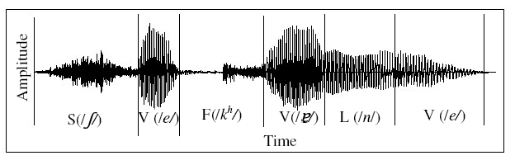
Pseudo word
If the pronunciation of a word is represented by the selected manner symbols then the new representation of the word is called pseudo word
As for example if the word is then the corresponding pseudo word after manner based labeling is SVFVLV
Cohorts
A group of words of same pseudo word representation forms a cohort. For Example cohort AVLLVAV consists of four Bangla words,
দিনমজুর, জন্মাবার, জন্মাবে, জন্মিবে

Slide 82
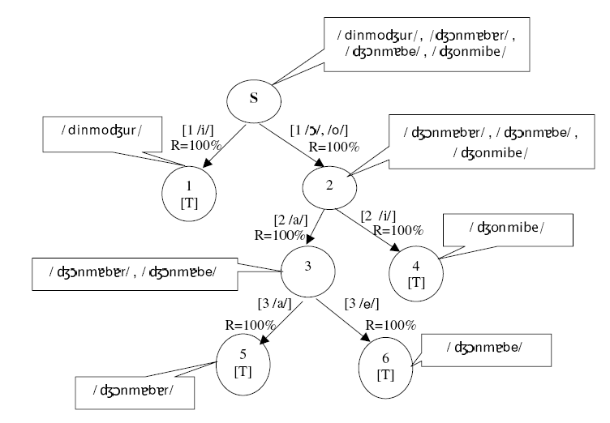

Slide 83
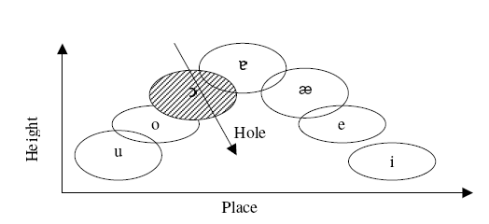

Slide 84
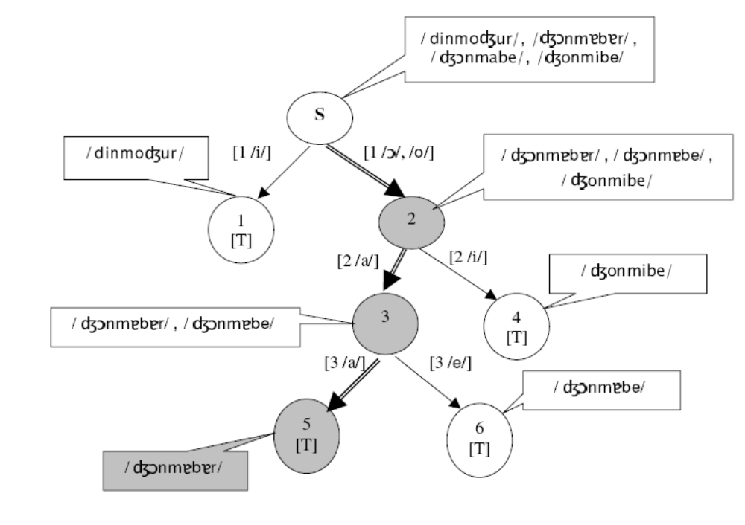

Slide 85
Thus the actual recognition rate =recognition rate of manner based labeling x over all recognition rate of the cohort =94*95.5 =90% (Using Manner Based Lexically Driven (MBLD) Model of Speech Recognition )

